Slide 1
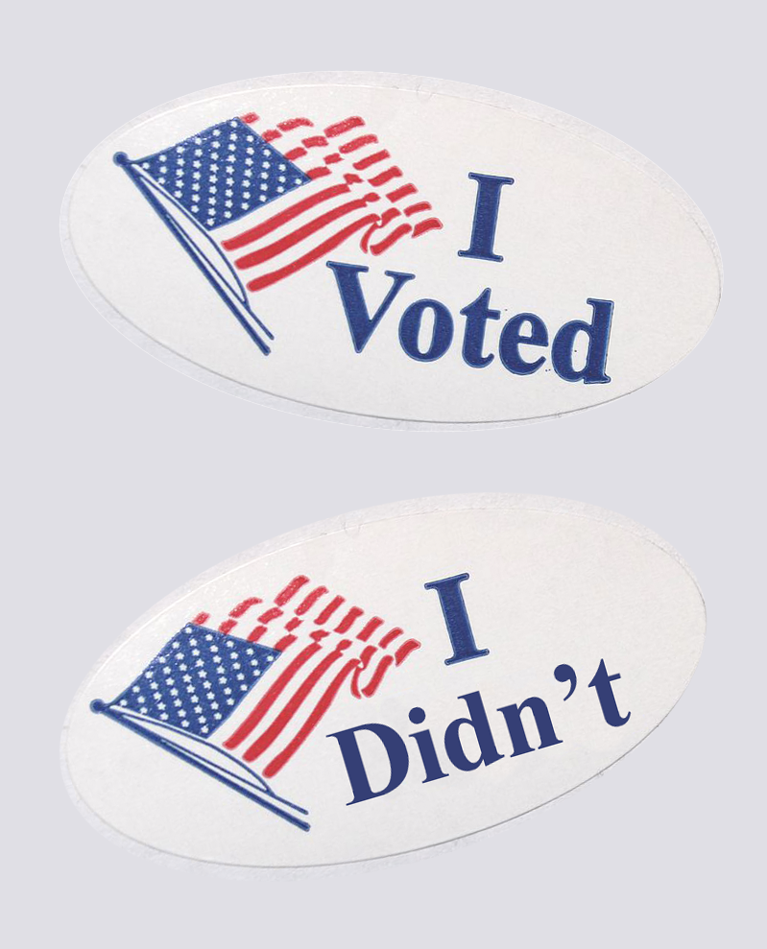
VOTER AND Non-voter Data
Group 2 :
Andrea Bradshaw, Julia Haslanger, Steven Latta, Barbara Schweitzer

Slide 2
Data overview
Data from a FiveThirtyEight survey of US citizens
8,327 people responded to the survey, of those, 1,451 people rarely or never vote
Questions in the survey were a mix of demographic and psychographic
Key questions addressed things like why they decided not to vote, how they would prefer to vote (e.g. mail-in, early, day-of), what they think would get more people to vote
Because it was an online survey, it oversampled younger ages

Slide 3
The business question
How could colleges and universities focus marketing efforts to increase voter participation of their students and recent alumni?
What beliefs or other indicators are characteristic of non-voters, which could be addressed in these marketing efforts?

Slide 4
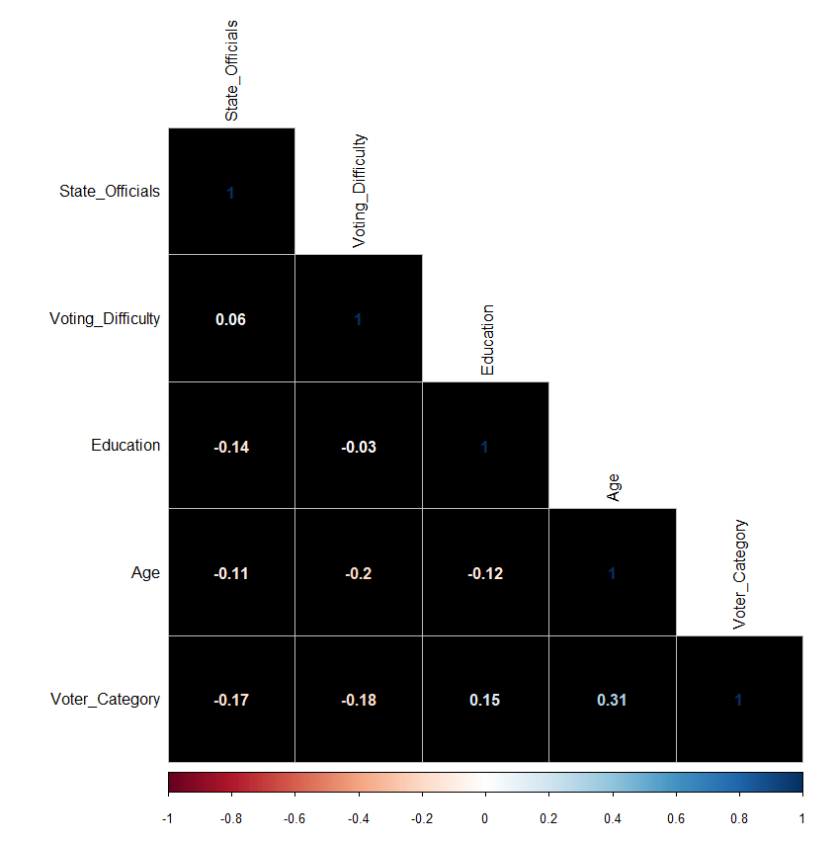
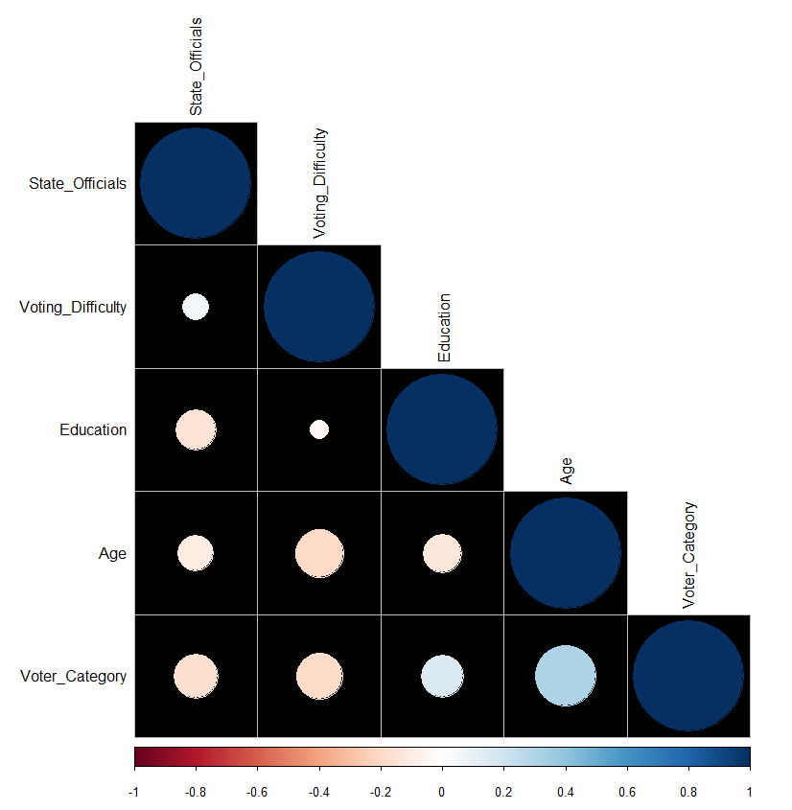
Clustering results
Top 4 Correlations w/ Voting Frequency:
As age increases, voting increases
As difficulty voting decreases, voting increases
The more people believe state officials impact their lives, the more they vote
As education increases, voting increases

Slide 5
Clustering results: 4 clusters
Oldest Voters (Avg age ~74)
•Lowest Income
•Most white voters
•Believe most in impact of DC, state & local elected officials
•Vote most & have easiest time voting
Older Voters (Avg age ~60)
•Most female & black voters
•Least educated
Highest Income Voters (Avg age ~45)
•Most Hispanic
•Believe least in impact of local elected officials
Youngest Voters (Avg age ~29)
•Most males, most other/mixed voters
•Most educated
•Vote least & have hardest time voting
•Believe least in impact of DC & state elected officials

Slide 6
Understanding KEY SUBSET: People with some college or a college degree who don't vote:
Psychographic:
20% don't want to register to vote
"don’t trust the political system to serve my needs"
"don’t think my vote matters"

Slide 7
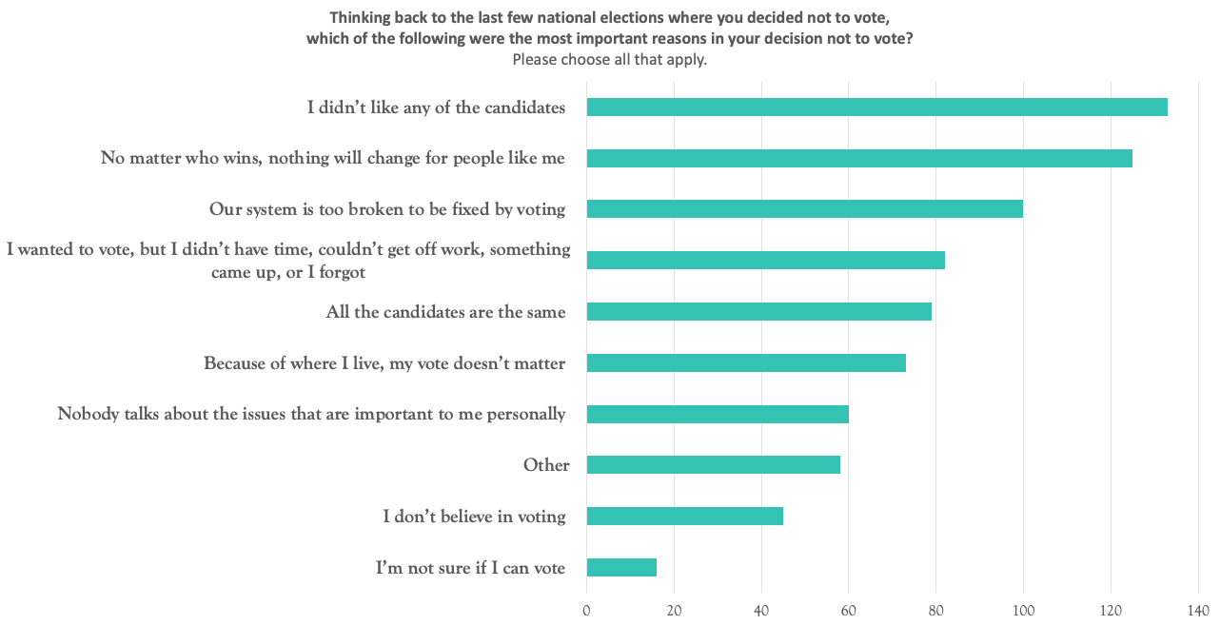

Slide 8
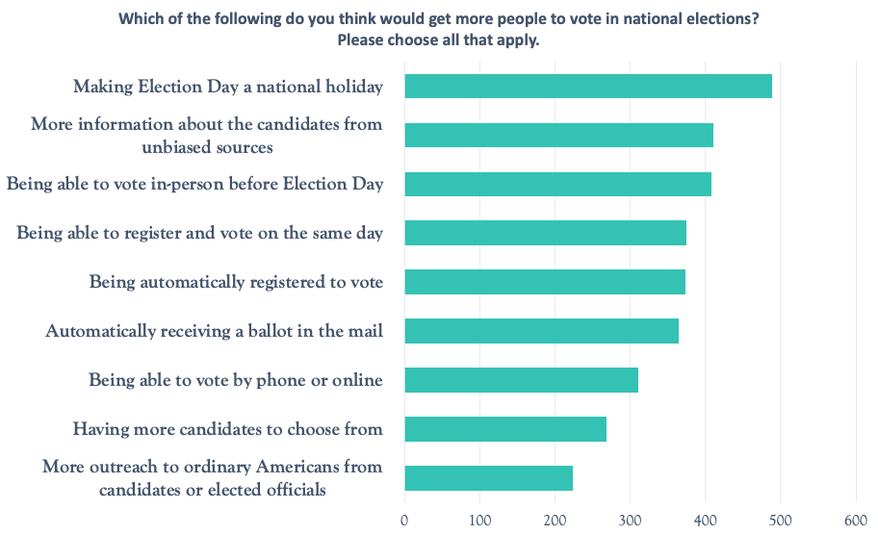

Slide 9
Can we predict potential Voters? Logistic Regression

Slide 10
Logistic regression Approach
Used an R function to create training and testing data sets
Each data set was created to have a roughly equal percentage of voter / non-voter data entries
High dimensionality: used another R function to determine which features (attributes) were important
Created 3 different models
Only Demographic
Demographic and Survey Responses
Only Survey Responses

Slide 11
Logistic regression results (Demographic variables)
Demographic variables provided included age, education, gender, race, and income level
Used age, education, race, and income level for this regression
Gender was not significant (p-value above 0.05)
Education level had the largest impact on a participant’s propensity to vote
77% hit rate

Slide 12
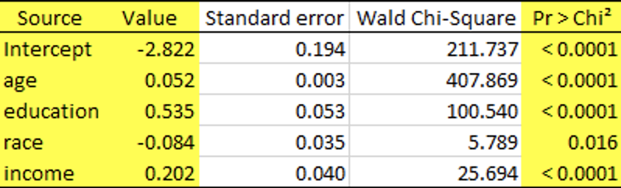
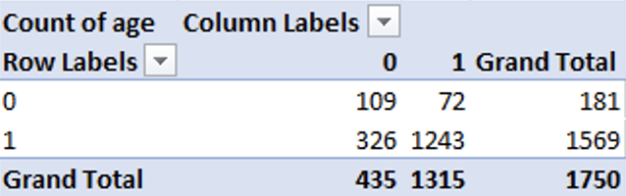
Logistic regression results (Demographic)
109+ 1243
= .7726 or 77.26%
72 + 1243 + 326 + 109

Slide 13
Logistic regression results (Survey variables)
Survey Questions Used
Q2_1 – How important is to vote?
Q18 (all) - Have you had issues attempting to vote in the past?
Q20 – Are you currently registered to vote?
Q27 (all) - Did you vote in past elections?
Political Affiliation
86% Hit Rate

Slide 14
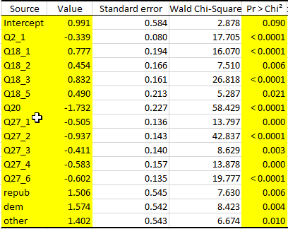

Logistic regression results (Survey)
249 + 1273
= .8697 or 86.97%
249 + 1273 + 43 + 185

Slide 15
Logistic regression results (Demographic & Survey variables)
Combined the Demographic and Survey Variables
More likely to vote
No issues with prior voting
Already a registered voter
Voting is important to being an American citizen
Voted in prior elections
College Education
87% hit rate

Slide 16
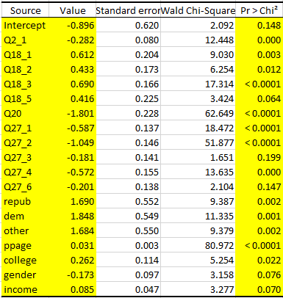
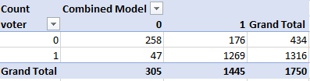
Logistic regression results (Demographic & Survey)
258 + 1269
= .8725 or 87.25%
47 + 1269 + 258 + 176

Slide 17
Recommendations
To determine who/whether to target pro-voting marketing materials:
If have relevant info about student body (age, income, race, education level, whether registered to vote, whether voted in the past, etc.) use equation to predict how likely students are to vote or not in the next election.
Can also run this on alumni rolls if available to predict how likely alumni are to vote.
Make more information available about state and national candidates/issues
Invite candidates to university campuses to meet with students and alumni
If campus is in an area with early voting or same-day registration, make sure that's noted in marketing materials

